Slide 1

Dept. Of Computer Science & Engineering
Proposal Presentation
Of Team Bratva
Course Code: CSE-3524 Course Title: Microprocessor, Microcontrollers & Embedded System
Submitted to-
Md. Safayat Hossen
Assistant Lecturer, Dept. of CSE, IIUC
Cell: 01736161688, safayathossen@iut-dhaka.edu

Slide 2
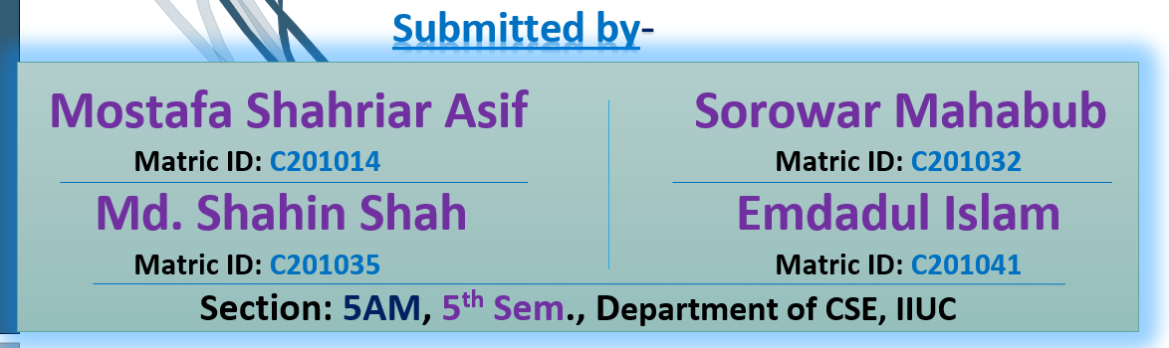
Our Proposal Project Name:
Speed Test of a Moving Object
Team Bratva
Page- 02

Slide 3
Speed Test of a Moving Object
Motivation:
What if the moving object Speed Detection is made automatic?
A simple automatic detection of speed of a moving object is designed in Arduino moving object Speed Detector project, where you can place the system in one place and view the results instantly without any human intervention.
Page- 03

Slide 4
Speed Test of a Moving Object
Features:
Helps in capturing speed of moving object.
Can display the speed of a moving object.
No need of human involvement.
This project can also be used as traffic logger, traffic counter and few other traffic related applications.
Page- 04

Slide 5
Speed Test of a Moving Object
Limitations:
It can’t capture speed of all kinds of moving object, like fan.
It has not any sound system, that tells you the speed.
Future Scope:
In Future, we can add sound system in this project. By adding sound system, it can tell you the speed of a moving object besides showing the speed in display.
Page- 05

Slide 6
Speed Test of a Moving Object
Social Impact:
Have Look at the example:
There are definite rules laid out by authorities about driving cars on roads. The most common rule in any country is speed limit in certain roads i.e., you will be in violation of the law if your car speed exceeds this limit. In that case, one can place the system in one place and view the results (speed) instantly without any human intervention.
Page- 06

Slide 7
Speed Test of a Moving Object
Sensors and Equipment’s:
Arduino UNO
IR Sensors x 2
16X2 LCD Display Module
Breadboard
Connecting Wires
Power Supply
Page- 07

Slide 8
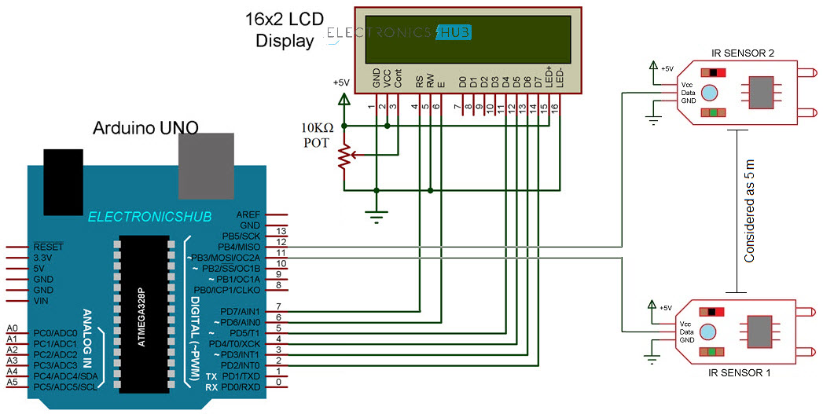
Speed Test of a Moving Object
Circuit Diagram:
Page- 08

Slide 9
Speed Test of a Moving Object
Cost Analysis:
Arduino UNO x 1 - 1250 TK
IR Sensors x 2 - 160 TK
16X2 LCD Display Module x 1 - 250 TK
Breadboard x 1 - 130 TK
Connecting Wires - 50 TK
Power Supply x 1 - 150 TK
Here, Our Total Estimated Cost Is 2000 TK To 2200 TK.
Page- 09

Slide 10
Speed Test of a Moving Object
Application:
The goal of measuring speed may vary based on the application-
Including the safer operation of vehicles;
Calculation of power as a product of speed and force;
Evaluation of driver travel routes based on fuel efficiency and travel time;
Fuel level tracking to prevent fuel theft, etc.
This is The End.
Assalamualaikum Waa Rahmatullah to All, Thank You!
Page- 10

